Slide 1
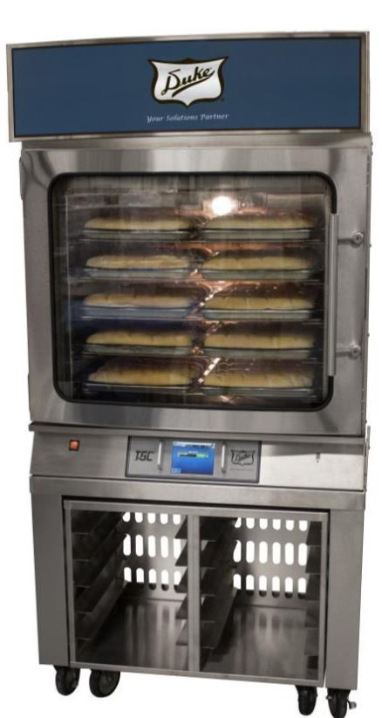

Duke FlexBake5™ Proof & Bake Oven
Operations Training
Baking Great Bread has Never Been Easier
TEST

Slide 2
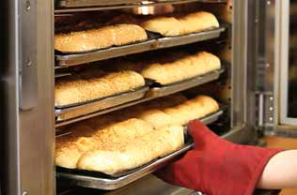
Overview
Proof and bake in a single cavity
  50 breads per cycle
  65 min. proof and bake cycle + 10 min. cool down cycle (if baking bread immediately after)
Benefits:
  Simplifies the bread baking process and improves product consistency
  Single cavity reduces user handling, time and labor allowing employees to focus on other tasks
  Ability to expand into artisan bread products with steam feature

Slide 3
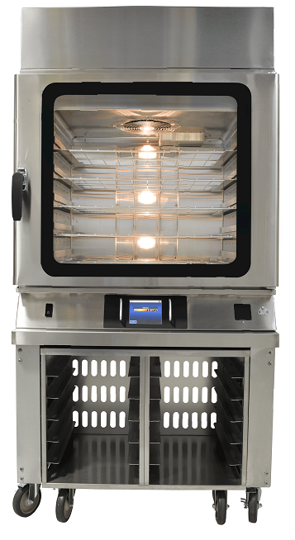


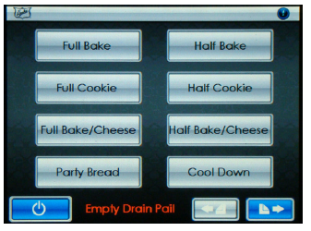
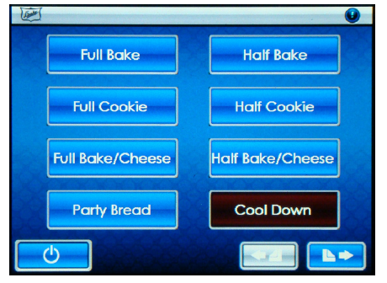
Power On Oven
2 step Process:
1) Turn on main power using the rocker switch to left of control panel screen
2) Press
on ‘Main Screen’ to turn on the oven

Slide 4
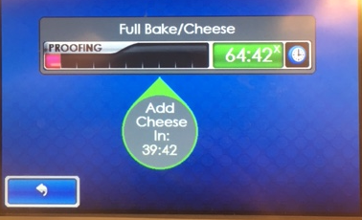
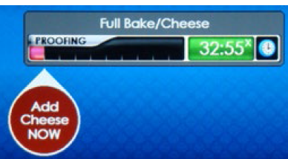
Selecting a Recipe
Select the appropriate recipe from the main screen
Half bake vs. Full bake (cookies or bread):
  Choose half bake if baking 5 pans or less
W/Cheese recipes
  Must be selected in order for icon to appear and alarm to sound notifying appropriate time to add cheese
  Can mix cheese and non-cheese breads in same load

Slide 5
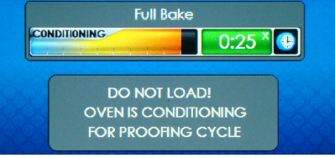
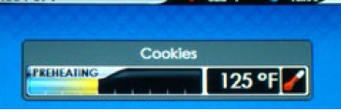
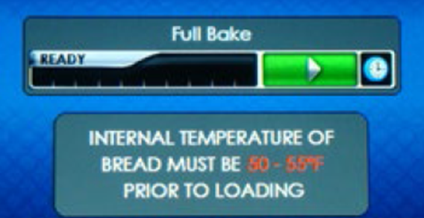
Recipe Cycles
One a recipe is selected the oven will either begin “conditioning” or “preheating”
Conditioning is a longer preheating cycle and occurs if a bread recipe has been selected and the oven was previously off. This cycle takes approximately 20 minutes – a count down timer is display
The oven will begin preheating if a non-bread recipe is selected and it is under the temperature set-point. This cycle takes 5-10 minutes
Once the conditioning or preheating cycle is complete an alarm will sound (3 short chirps) and the display will change to the ‘Recipe Ready to Start Screen.’

Slide 6
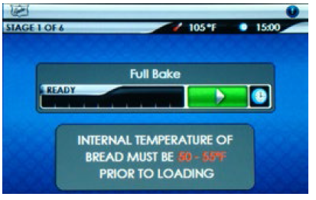

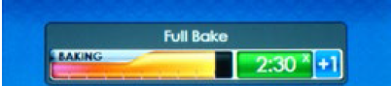
Recipe Cycles
Load the oven and press the start timer button to begin the recipe.
  **Follow all current bread baking steps, including spraying and floor retarding the bread to proper temperature – except the temperature requirement has changed to 55-60 degrees (not 50-55)
If you wish to choose a different recipe prior to starting, press the ‘back button’ on the lower left hand corner of the screen
To cancel a recipe once it has started, press and hold the countdown timer for 2-3 seconds

Slide 7

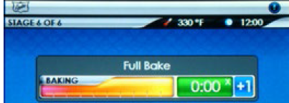
Recipe Cycles
Recipe Alarms:
  During Bread Baking Recipes: “20 Minute Alarm” - When there are 20 minutes left in a bread cycle, there will be a brief alarm that sounds and messaging will appear on the screen alerting you to begin retarding the next batch of bread
  During all Baking Recipe: “2 Minute Alarm” - A few short beeps occur 2 minutes prior to the end of a recipe allowing you to review product color and add or subtract time if needed
You may add time onto the end of a bake in one minute increments with the ‘+1’ button
  Button appears once a proof/bake cycle enters it’s last stage which is baking
  This will only adjust the color of the bread, not the size
When the bake is complete, an alarm will sound. Touch the timer or open the door to cancel the alarm

Slide 8
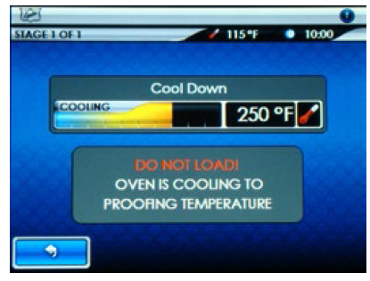
Recipe Cycles
Cool Down Cycle
Once a recipe is complete, if baking a bread recipe that requires a proofing temperature, the cool down cycle must be selected from the main menu. If cool down is not selected and a bread recipe is selected, the oven with automatically default to cool down. They cycle takes approx. 10 minutes
If baking cookies or flatbread, a cool down cycle is not necessary

Slide 9
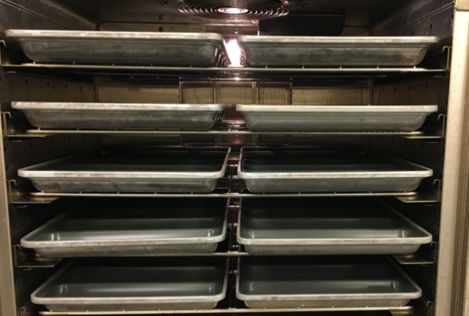
Best Practices with the Flexbake5 Oven
  Follow all current bread baking steps, including spraying and floor retarding the bread to proper temperature – except the temperature requirement has changed to 55-60 degrees (not 50-55)
  It is critical the bread is at the proper temperature of 55-60 degrees. The proofing time can not me modified to adjust for under or over floor retarding
  When running a bread bake, there will only be a light misting of water on the door during proofing, this is normal
  Pan Placement:
    Pans should be placed with spacing in the center and not touching
    For half bakes: start with middle rack, then place pans on the rack above, then on the rack below
  Metal bread forms: require an extra 2-3 minutes to be added to the end of the bake cycle

Slide 10
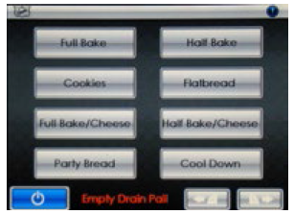
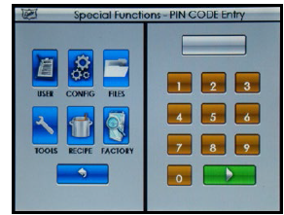
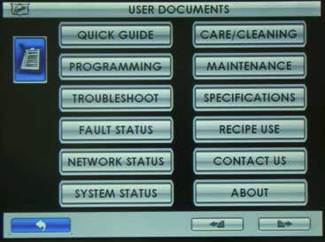
Additional Helpful Information
Helpful ‘User Functions’ can be accessed through ‘Special Functions Screen’.
Press the icon in the upper right corner of the screen, then choose user
  The Quick User Guide/Training can be found here, along with network and fault status and all maintenance and cleaning information

Slide 11

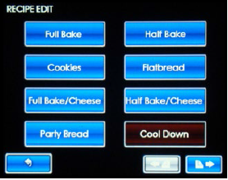
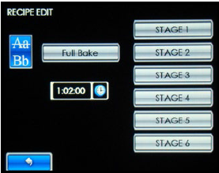
Editing Recipes
If a recipe needs to be edited, this can be done by accessing the ‘Special Functions Screen’ by pressing the in the upper right hand corner
Select Recipe: Pin code: 5678
Select which recipe to edit
The last stage of each recipe is the proper place to permanently edit bake time.
  It is strongly recommended not to make changes to any of the other stages, as this could significantly affect the quality of baked product
If you are utilizing metal bread forms, 2-3 minutes will need to be added onto the bread baking cycles

Slide 12
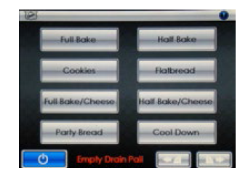
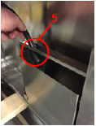
Maintenance and Cleaning
Empty Drain Pan Message
  This message will appear each time the oven is turned on and after every 3rd Cool Down Cycle.
  To empty the drain pan, remove the rolling rack under the oven stand (if present) and locate the drain pan on the lower right side of the oven and remove the line.
  If your drain line is ran straight to a drain, this message can be turned off in the settings (configurations)

Slide 13
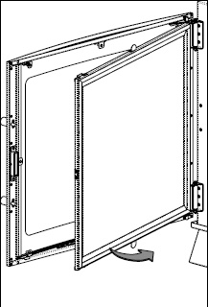
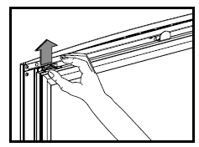
Maintenance and Cleaning
Daily Tasks:
  Poor a large cup of hot water through the cavity bottom drain to flush through any debris
  Wipe the drip tray clean
  Clean oven exterior and doors
  Wipe clean interior of oven with hot soapy water followed by damp cloth
Weekly Tasks
  Clean the Cool-Touch door
    Separate the panes via the clips at the top and bottom of the door
  Inspect oven door gaskets for damage
Monthly Tasks
  Check door screws for tightness
Yearly Tasks
  The Reverse Osmosis System pre-filter should be replaced yearly, and the membrane should be changed every other year.

Slide 14
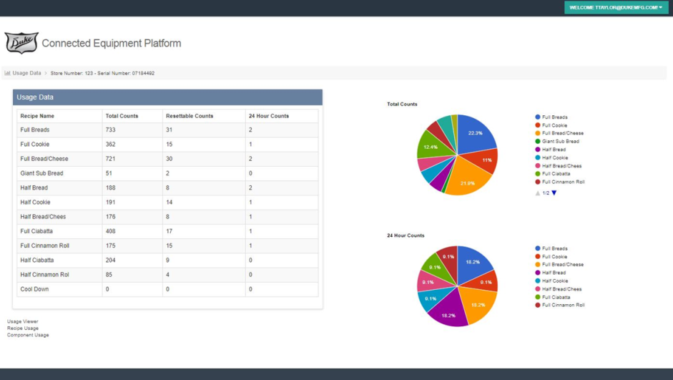
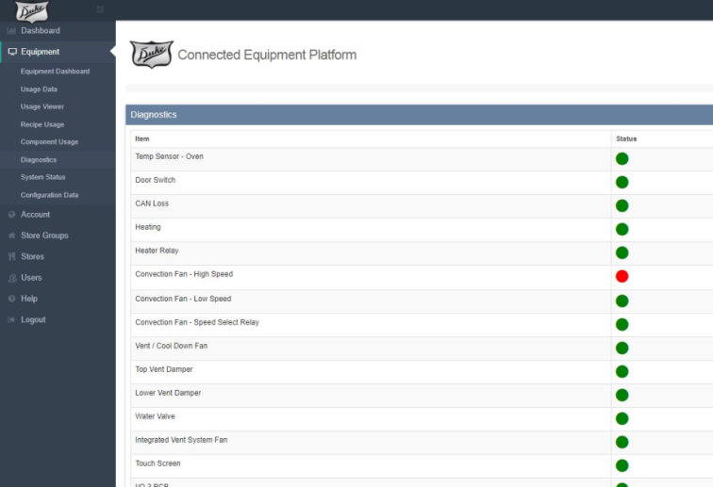
WIFI Feature
Allows for remote recipe management
  Push new recipes to selected restaurants
  Remotely view what is being baked at the store
Allows for advanced diagnostics
  Remote service alerts available
  On-screen fault errors displayed
  Duke technicians can remotely troubleshoot to resolve issues quicker

Slide 15
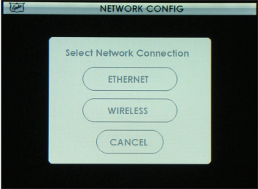
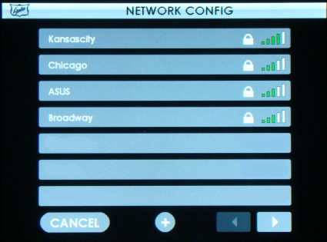
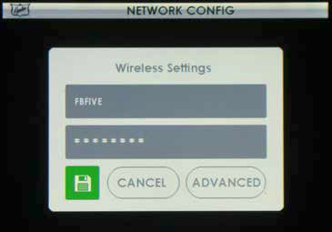
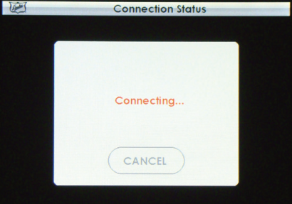
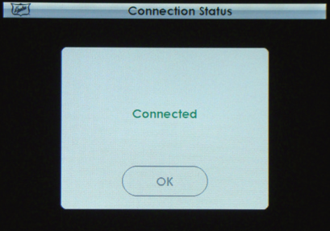
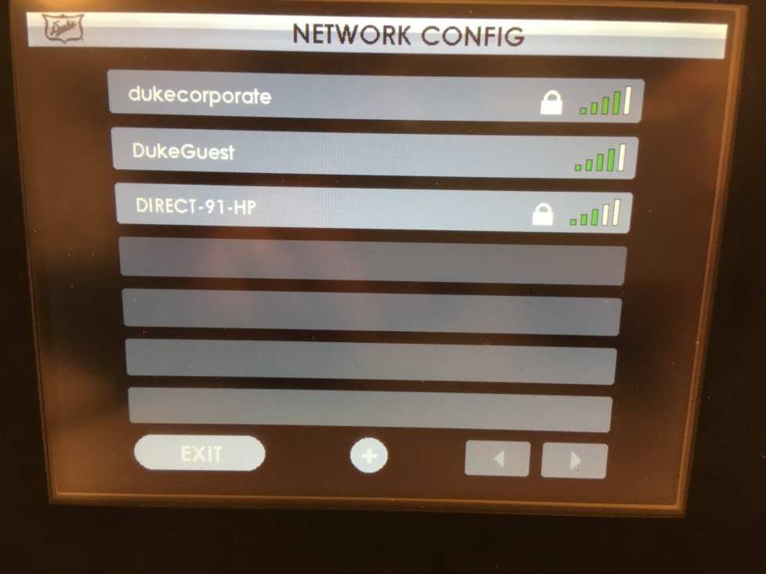
WIFI Feature - Access
To access Special Functions, press in top right corner
Press CONFIG, then enter PIN 2345
Select NETWORK CONFIG
Choose either ETHERNET or WIRELESS
If WIRELESS is pressed, choose from list of available sites and enter your password. Then press green save button
System will attempt to connect and will show “connecting”
Once connected it will display “connected”. Press OK

Slide 16
Questions?
Mike Powers
mpowers@dukemfg.com
1-800-735-3853 ext. 1343
Tracey Ounanian
tounanian@dukemfg.com
314-422-6768

